Slide 1
Addition and Subtraction
Assume that the numbers are represented using 2’s complement representation scheme.
If two numbers a and b are to be added,
  Use an n-bit adder to add them.
  Output: n-bit Sum + Carry out
For computing a − b, use a + (− b).
  -b can be computed by inverting all bits and adding 1.
  In an adder/subtractor combined, XOR gates used to invert. Carry_in set to 1 to “add 1”.

Slide 2
Overflow/Underflow
When the result can not be represented in the allocated number of bits.
  Result > Max that can be represented ➔ Overflow.
  Result < Min that can be represented ➔ Underflow.
Unsigned number representation using n bits
  Overflow when the result > 2^{n} −1
  Underflow when result < 0.
Signed number representation using n bits
  Overflow when result > 2^{n−1} −1
  Underflow when result < −(2^{n −1})

Slide 3
Addition of Unsigned Numbers: Overflow/Underflow
n=4 bits, To compute (4 + 8)
  4’d4 = 4’b0100 4’d8 = 4’b1000
0
1
0
0
Carry out indicates Overflow in addition.
Addition will not underflow in case of unsigned numbers
Carry_out = 0 in Addition
1
0
0
0
1
1
0
0
n=4 bits, To compute (9 + 8)
  4’d9 = 4’b1001 4’d8 = 4’b1000
1
0
0
1
Carry_out = 1 in Addition
1
0
0
0
0
0
0
1

Slide 4
Overflow/underflow in Subtraction using Unsigned Numbers
n=4 bits, To compute (5 − 6)
  4’d5 = 4’b0101 4’d6 = 4’b0110
1
Carry_in =1
0
1
0
1
Carry_out = 0 in subtraction
1
0
0
1
Bitwise inverted
1
1
1
1
n=4 bits, To compute (7 − 6)
  4’d7 = 4’b0111 4’d6 = 4’b0110
1
Carry_in =1
0
1
1
1
Carry_out = 1 in subtraction
1
0
0
1
Bitwise inverted
0
0
0
1
~C_out indicates Underflow in subtraction.
Subtraction will not overflow for unsigned numbers

Slide 5
Addition of Signed Numbers: Overflow/Underflow
While adding a positive number with a negative number
  No overflow or underflow can occur.
Overflow can occur when two positive numbers are added and result is out of range.
  After addition, the result will become negative.
Underflow can occur when two negative numbers are added and result is out of range.
  After addition, the result will become positive.

Slide 6
Signed Addition
Overflow Condition (C = A + B)
  Sign of A(S_{A})=0, S_{B}=0. S_{c}=1.
S_{c} can become 1 only when Carry into the sign bit is 1. In that case, Carry out of the sign bit is 0.
Underflow Condition (C=A+B)
  Sign of A(S_{A})=1, S_{B}=1. S_{c}=0
S_{c} can become 0 only when Carry into the sign bit is 0. In that case, Carry out of the sign bit is 1.
Overflow/Underflow = (Carry_in <> Carry_out)
  Carry_in: Carry into the sign bit.
  Carry_out: Carry out of the sign bit.

Slide 7
Subtraction of signed numbers
Operation C = A + (-B)
Overflow: S_{A}= 0, S_{B} = 1, S_{C} = 1
Underflow: S_{A}= 1, S_{B} = 0, S_{C} = 0
Overflow/Underflow Condition:
  Carry_in == Carry_out
  Carry_in is Carry into the Sign bit.
  Carry_out is Carry out of Sign bit.

Slide 8
Overflow/Underflow
If the carry out in the subtraction is inverted (to reflect the borrow) overflow/underflow conditions become independent of add/subtract.
Unsigned Overflow/Underflow: Carry out of the adder = 1
Signed Overflow/Underflow:
  Carry into Sign bit <> Carry out of Sign bit.

Slide 9
Shift Operation
Shift left “<<” operation.
  Shift the bit string left by k bit positions.
  Bits on the left are shifted out (disappear)
  Incoming bits on the right are set to 0.
Outgoing bits
Left shift by k bits is equivalent to multiplying the number by 2^{k}.
0
1
0
1
1
0
1
0
1
Left Shift by 2 bits
0
1
1
0
1
0
1
0
0
Incoming bits

Slide 10
Shift Operation
Right shift
  Unsigned Shift and signed shifts are different.
In unsigned shifts incoming bits on the left are set to 0.
In signed shifts incoming bits on the left are kept the same as the original sign bit.
Outgoing bits on the right are just dropped.
Right shift by k bits is equivalent to divide by 2^{k}.

Slide 11
Carry Lookahead (CLA) Adder
Full Adder Equation.
  Cout = (A+B).C + AB
    Also same as (A ⊕ B).C + A.B
  S = (A ⊕ B) ⊕ C
Let as create two signals
  p = A ⊕ B (aka Propagate Signal)
  g = A.B (aka Generate Signal)
Cout = p.C+g
S = p ⊕ C.

Slide 12
A= 01101
B = 00011
p₀ = 1 ⊕ 1 =0, g₀ = 1.1 =1
p₁ = 0 ⊕ 1 = 1, g₁ = 0.1 =0
p₂= 1 ⊕ 0 = 1, g₂ = 1.0 =0
p₃= 1 ⊕ 0 = 1, g₃ = 1.0 =0
p₄= 0 ⊕ 0 = 0, g₄ = 0.0 =0

Slide 13
CLA Adder
In an n-bit adder,
  Let A_{i}, B_{i} and C_{i} be the input bits and carry in.
  Let S_{i} and C_{i+1} be the sum and carry out.
Now, C₁ = p₀C₀ + g₀
C₂ = p₁C₁ + g₁
  = p₁p₀C₀ + p₁g₀ + g₁
C₃ = p₂C₂ + g₂
  = p₂p₁p₀C₀ + p₂p₁g₀ + p₂g₁+ g₂
C₄ = p₃C₃ + g₃
  = p₃p₂p₁p₀C₀ + p₃p₂p₁g₀ + p₃p₂g₁+ p₃g₂ + g₃
C₄ can be computed faster using this rather than through ripple carry.
  CLA adder is faster than ripple carry adder
  Delay O(log n) vs. O(n)

Slide 14
Multiplication of binary numbers
Multiplicand
Multiplicand: The number to multiply
Multiplier: The number by which to multiply.
Product: The result.
Partial Products:
  Product of multiplicand with each bit of the multiplier.
1
0
0
1
Multiplier
×
1
0
1
1
1
0
0
1
Partial Products
1
0
0
1
0
0
0
0
1
0
0
1
Product
1
1
0
0
0
1
1

Slide 15
Steps of Multiplication
Partial Products: obtained by multiplying each bit of the multiplier by the multiplicand.
  Can be obtained by an array of AND gates
Product: Sum of aligned partial products
Size of product:
  2n bits if the multiplier and multiplicand are n bits each.

Slide 16
Array Multiplier
a_in
p₀
s_in
c_in
p₁
b_out
b_in
p₂
a_out
s_out
p₃
c_out
module ArrayMultBlk(a_in, b_in, c_in,
s_in, a_out, b_out, c_out, s_out);
assign a_out = a_in;
assign b_out = b_in;
assign {c_out, s_out} = s_in + (a_in & b_in) + c_in;
endmodule

Slide 17
Combinatorial Multiplier
Is non-practical.
  Makes the clock cycle of the entire circuit slow.
It is better to use a sequential multiplication.
  Often known as shift-and-add multiplication.

Slide 18
First Version of HW Multiplier
Let’s assume that we are using unsigned numbers.
We first start with a combinatorial circuit.

Slide 19
First Sequential Multiplier Attempt
Initially, Multiplicand register has n 0 bits & Product reg 2n 0 bits.
Multiplicand Register (2n) bits
Left Shift
Multiplier Register
(n bits)
Adder (2n) bits
Right Shift
Control
Unit
Ready
Product Register (2n) bits
Write
Start
Clk

Slide 20
Second Version of Multiplier
Initially Product Reg has 2n 0 bits
Multiplicand Register
(n) bits
Multiplier Register
(n bits)
Adder (n) bits
Right Shift
Control
Unit
Ready
Product Hi
(n) bits
Product Lo
(n) bits
Write
Start
Right Shift
Clk

Slide 21
Third Version of Multiplier
Multiplicand Register
(n) bits
Lower half of the product register is initialized to the multiplier in the beginning.
Adder (n) bits
Control
Unit
Ready
Product Hi
(n) bits
Product Lo
(n) bits
Write
Start
Right Shift
Clk

Slide 22
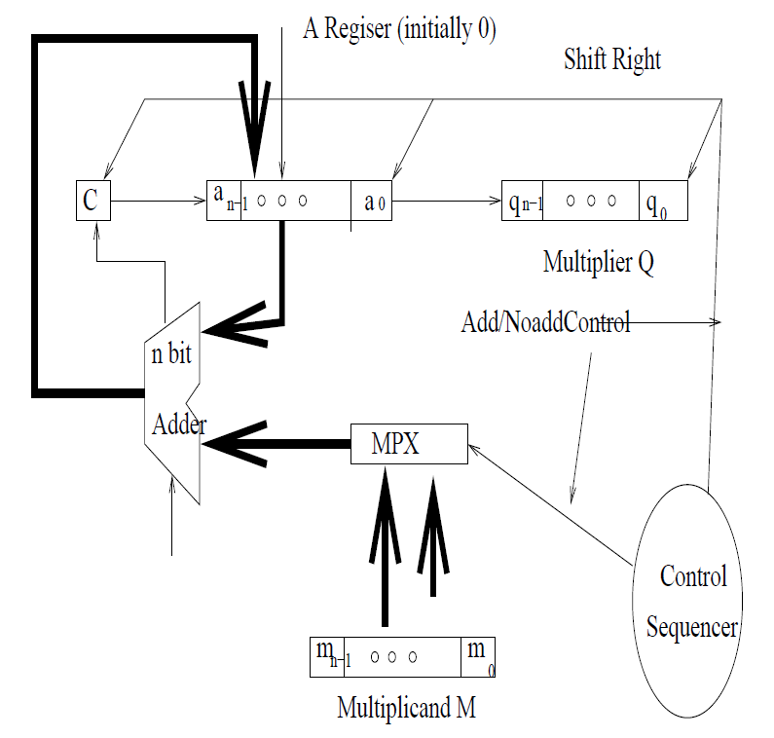
Multiplication

Slide 23
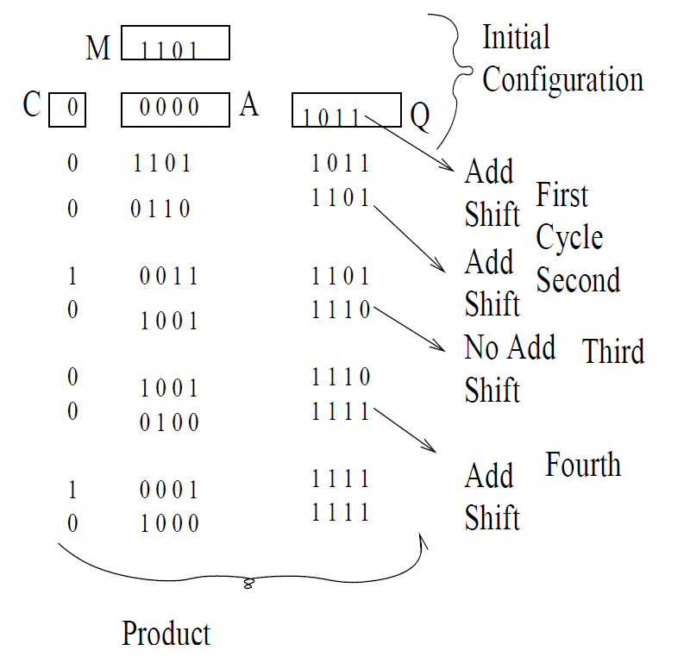
Multiplication

Slide 24
Signed Multiplication
Save sign of result = S_{A}^S_{B} in the beginning
Multiply the absolute values of the numbers
Put sign to the result.
But elegant solutions exist.
  Booth’s Multiplication Algorithm

Slide 25
Booth’s multiplication
Multiply
3456
x 9090
9090 = 10000-1000+100-10
3456x10000-3456x1000+3456x100-3456x10

Slide 26
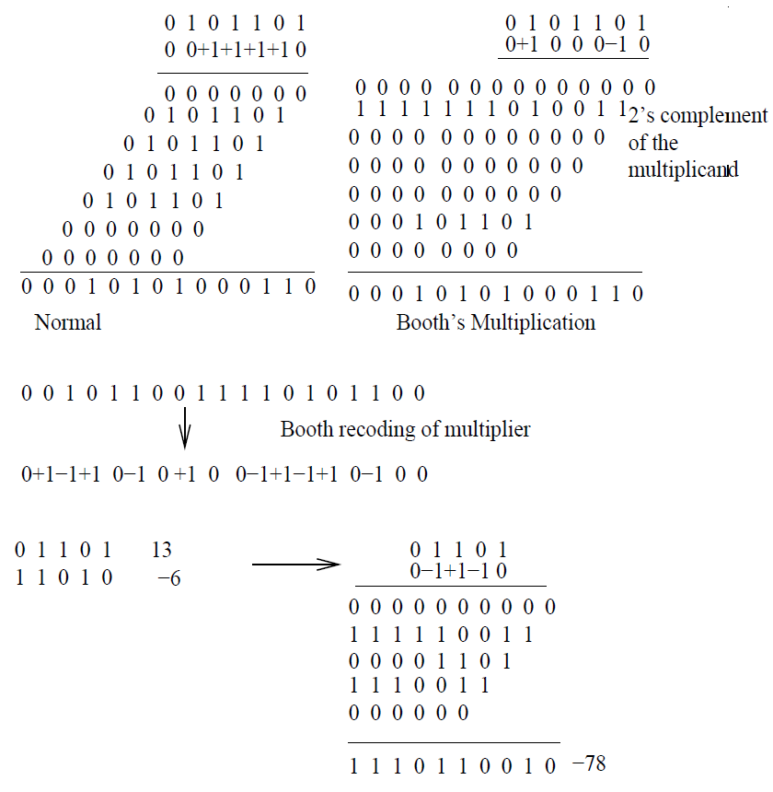
Booth’s Multiplication

Slide 27
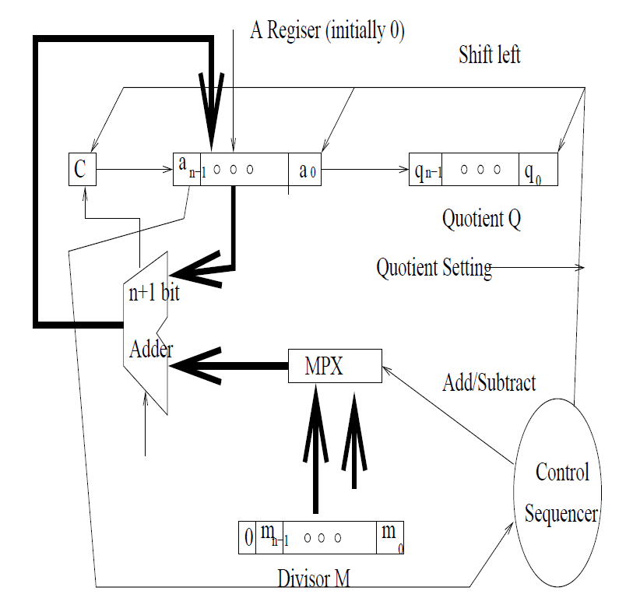
Integer Division

Slide 28
The restoring-division algorithm:
S1: DO n times
Shift A and Q left one binary position.
Subtract M from A, placing the answer back in A.
If the sign of A is 1, set q₀ to 0 and add M back to A (restore A); otherwise, set q₀ to 1.

Slide 29
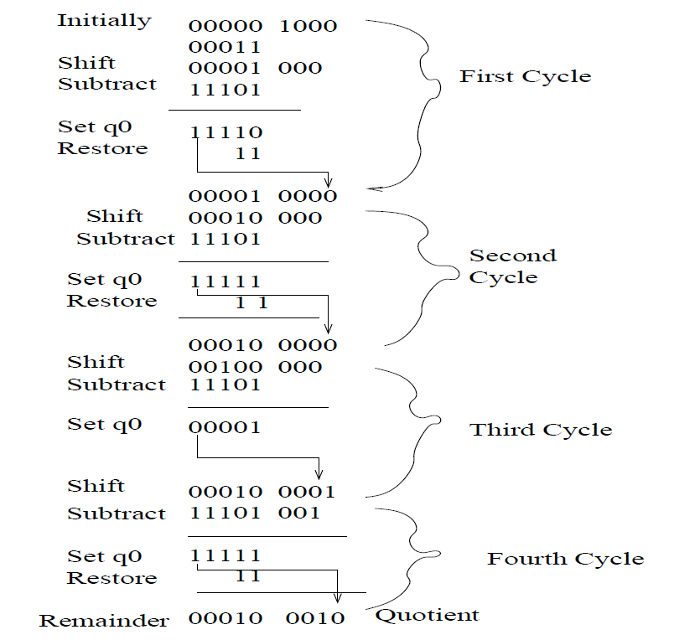
Restoring Division

Slide 30
Non-restoring Division
Step1: Do the following n times:
  If the sign of A is 0, shift A & Q left one bit position and subtract M from A (2A-M);
  Otherwise, shift A & Q left and add M to A (2A+M).
  If the sign of A is 0, set q0 to 1 else 0.
  Step 2: If the sign of A is 1, add M to A.

Slide 31
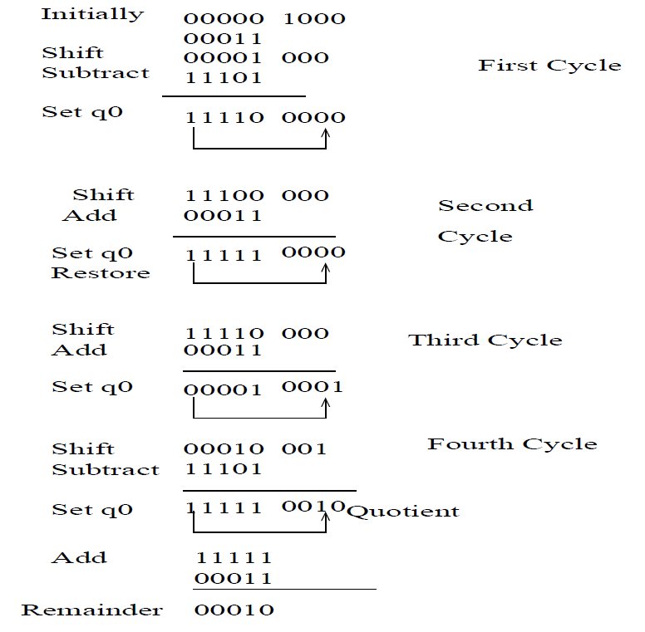
Non-Restoring Division

